Slide 1


Python + IOT
Course 6
Ver. 01
Copyright @ 2018 Innovaker

Slide 2


Course 5 Summary
. Basic concept of electric circuit
. What is LCD?
. Demo project --- LCD project
. What is temperature & humidity sensor?
. Demo project --- temperature & humidity project
2
Copyright @ 2018 Innovaker

Slide 3
quick review basic concept of Electricity
Electricity is the movement of electrons. Electrons create charge, which we can harness to do work. Your lightbulb, your stereo, your phone, etc., are all harnessing the movement of the electrons in order to do work. They all operate using the same basic power source: the movement of electrons.
The three basic principles for this tutorial can be explained using electrons, or more specifically, the charge they create:
Voltage is the difference in charge between two points.
Current is the rate at which charge is flowing.
Resistance is a material’s tendency to resist the flow of charge (current).
3
Copyright @ 2018 Innovaker
Notes:
Teacher notes:
Electricity is a natural phenomenon that occurs throughout nature and takes many different forms. In this tutorial we’ll focus on current electricity: the stuff that powers our electronic gadgets. Our goal is NOT to understand how electricity flows from a power source through wires, lighting up LEDs, spinning motors, and powering our communication devices.
Electricity is briefly defined as the flow of electric charge, but there’s so much behind that simple statement. Where do the charges come from? How do we move them? Where do they move to? How does an electric charge cause mechanical motion or make things light up? So many questions! To begin to explain what electricity is we need to zoom way in, beyond the matter and molecules, to the atoms that make up everything we interact with in life.
We do not have time to discuss and explain all of those concepts in this class, instead, we will focus on the electric circuit, and how its basic concept, and how it works.

Slide 4
What is Innovaker Digital Circuits Kits
Innovaker Digital Circuits Kit, is a special designed STEM kits. Using these tools from the kits, students can focus on electronic theory and programming instead of spending time making tedious wire connections. By undertaking a series of hands-on projects, students will learn how to develop rapid prototypes safely.
Innovaker Digital Circuits Kit includes:
. Pi PCB
. LED
. Resistor
. LCD
. Relay
. Buzzer
. Motion sensor
. Light sensor
. Button with cap
. 1uf Capacitor
. Temperature & Humidity Sensor
. Arduino Nano
4
Copyright @ 2018 Innovaker

Slide 5
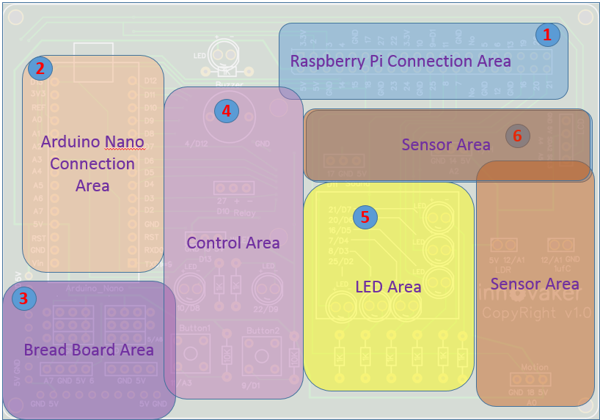
Innovaker Digital Circuits Kits layout
Innovaker Digital Circuits Kit, is a special designed STEM kits. It has built in Arduino Nano, and can connect to external Raspberry Pi.
5
Copyright @ 2018 Innovaker

Slide 6

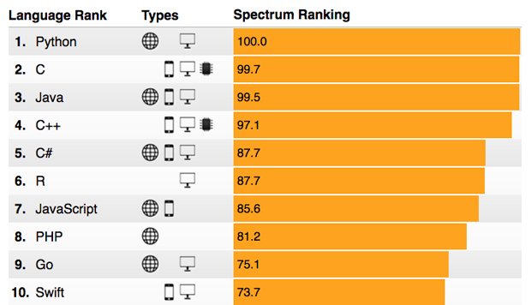
Raspberry Pi
remote access
option 2
Use network cable to connect with router to get IP
Connect Pi with router with ethernet cable, start Pi, the IP will be displayed on LCD, then remote connect to Raspberry Pi through VNC viewer.
Option 1: use monitor / keyboard / mouse to connect to wifi (see previous slide)
Copyright @ 2018 Innovaker
Notes:
IP address
Get Pi IP address is one important step to use Pi with laptop or other computer.
If IP address for example as “192.168.0.15” is displayed on LCD, go to chapter VNC.
Here is workflow how to get wifi IP address:
If there is no IP address is displayed on LCD, there are three ways to get IP.
Use monitor / keyboard / mouse to connect to wifi
Use network cable to connect with router to get IP
Use smartphone hotspot to get IP
Following chapter will introduce above IP methods.
Innovaker Kits special feature (not come with Raspbian)
Option 2: Use network cable to connect with router to get IP
Connect Pi with router with ethernet cable, start Pi, the IP will be displayed on LCD, go to VNC chapter to setup Wifi or use directly.

Slide 7
Raspberry Pi
remote access
option 3
Use martphone hotspot to get IP
Set hotspot on smartphone,
the spot name “Pizhi”, password “innovaker”.
Start Pi with LCD, the LCD will display Pi IP of hotspot, go to VNC, then remote connect to Raspberry Pi through VNC viewer.
Option 1: use monitor / keyboard / mouse to connect to wifi (see previous slide)
Copyright @ 2018 Innovaker
Notes:
Innovaker Kits special feature (not come with Raspbian)
Option 3: Use martphone hotspot to get IP
Set hotspot on smartphone, the spot name “Pizhi”, password “innovaker”.
Start Pi with LCD, the LCD will display Pi IP of hotspot, go to VNC.

Slide 8
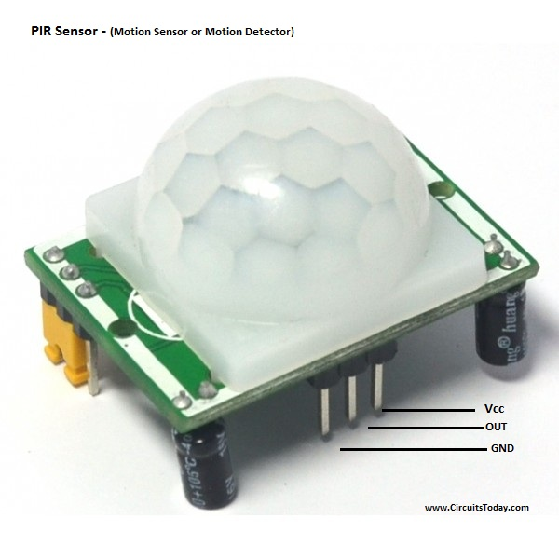
Electronic
component
--- motion sensor
Motion sensor
A motion sensor is a type of electronic sensor that detects for motion or movement. These are often found in security systems or motion sensing lights, but have a multitude of use cases. There are actually two types of motion sensors: active and passive. Active motion sensors emit ultrasonic waves which are reflected back to the sensor. When it detects a large disparity in the echo signal it receives, it sends out a signal to activate a different part of the system. Passive infrared sensors detect infrared or heat signals emitted by humans or other animals. These sensors are typically robust enough to differentiate between changes in daytime temperatures versus that of a living creature. The sensors included in this kit are passive infrared sensors.
How does it work?
The passive infrared sensor is included with 3 pins: one for power, one for ground, and one for the signal. The infrared sensor will detect for any abrupt changes in its infrared signal, and upon detection, will send a digital output to trigger another event.
Copyright @ 2018 Innovaker
Notes:
Teacher notes:
a PIR sensor which is also known as Pyroelectric sensor or Passive Infrared Sensor is basically an electronic sensor employed in motion detecting applications. A PIR sensor detects or measures IR (Infra Red) radiations emitted by any object inside its field of view.
A PIR sensor is generally known to the world as motion sensor or motion detector. We can actually build motion sensors or motion sensing lights we get on market with the help of Arduino and PIR sensors. So this tutorial is also a beginning guide to build motion sensor or a motion detector based on arduino. Lets learn how to interface a motion sensor/detector to arduino!
Lets brief how a PIR sensor operates!
In a practical aspect, all objects emit heat energy in the form of radiation. The theory behind this concept is that all objects with a temperature above absolute zero ( absolute zero is -273.15 degree celsius or zero kelvin) emit heat energy in the form of radiation at infra red wavelengths (invisible to human eyes). These emitted infra red radiations can be detected with the help of electronics and this principle is employed in the design of a PIR sensor. A PIR sensor do not emit any kind of radiation for detection purposes but they just measure the infra red radiation emitted by other objects inside its field or range of measurement.
Assemble the circuit as shown in diagram given below. A PIR sensor module has only 3 pins – one is Vcc which is a +5 volts input, a ground pin and finally the digital output pin. Connect +5V from Arduino to Vcc of PIR sensor module, connect a GND from Arduino to ground of PIR sensor and finally connect the output pin (marked as ‘out’) to any digital pin of arduino. In our circuit diagram, we have connected it to pin 7 of arduino.

Slide 9
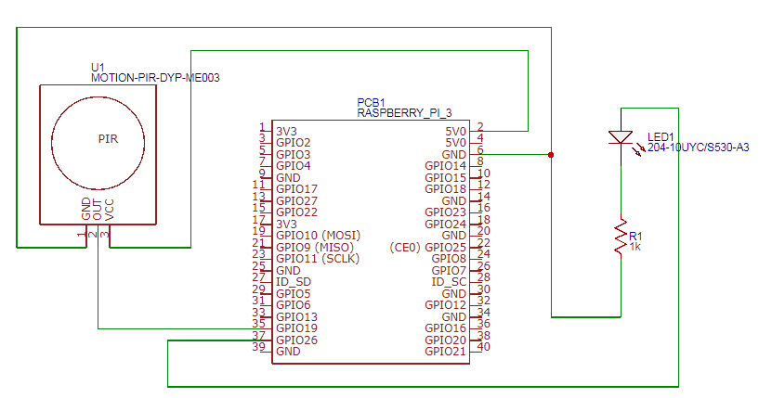
Motion sensor
diagram
Copyright @ 2018 Innovaker
Notes:
Teacher notes:

Slide 10
Demo Project
Motion sensor I
import RPi.GPIO as GPIO import time
LED_PIN = 10 MOTION_PIN = 18
def setup(): GPIO.setmode(GPIO.BCM) GPIO.setup(LED_PIN, GPIO.OUT) GPIO.setup(MOTION_PIN, GPIO.IN, pull_up_down=GPIO.PUD_DOWN) | The setup for the motion sensor is much like that of a button with an extra parameter for the pull_up_down
Copyright @ 2018 Innovaker
Notes:
Teacher notes:
Writing the Code
The following code lights up an LED if motion is detected from the sensor. Much like the button, we can implement this in either a loop or using a callback. These infrared sensors require a buffer time before they can be accessed again, so give them a larger sleep time in between detections.

Slide 11
Demo Project
Motion sensor II
def main(): while True: value = GPIO.input(MOTION_PIN) if value: GPIO.output(LED_PIN, GPIO.HIGH) time.sleep(3) else: GPIO.output(LED_PIN, GPIO.LOW) | We can use the GPIO.input function to detect the state of our motion sensor and light up the LED based on that status.
if __name__ == '__main__': try: setup() main() finally: GPIO.cleanup()
Copyright @ 2018 Innovaker
Notes:
Teacher notes:

Slide 12
Demo Project
additional demo
Copyright @ 2018 Innovaker
Notes:
Teacher notes:
additional demo
How to show more demo of use the button + LED + resistor circuit

Slide 13
Additional
Demo Project
Motion sensor I
import RPi.GPIO as GPIO import time
LED_PIN = 10 MOTION_PIN = 18
def setup(): GPIO.setmode(GPIO.BCM) GPIO.setup(LED_PIN,GPIO.OUT) GPIO.setup(MOTION_PIN, GPIO.IN, pull_up_down=GPIO.PUD_DOWN) GPIO.add_event_detect(MOTION_PIN, GPIO.RISING, callback=motionCallback, bouncetime=200) | Similarly to our callback implementation of the button, we use the GPIO.add_event_detect method to add a callback function that is implemented when a motion is detected The bouncetime parameter offers some buffer time before the motion detection can be retriggered
Copyright @ 2018 Innovaker
Notes:
Teacher notes:

Slide 14
Additional
Demo Project
Motion sensor II
def main(): while True: time.sleep(0.01) if GPIO.input(MOTION_PIN): print("Motion detected") else: print('No motion detected') | The main function simply keeps our program running so our callback can be triggered
def motionCallback(channel): if GPIO.input(channel): GPIO.output(LED_PIN, GPIO.HIGH) time.sleep(3) GPIO.output(LED_PIN, GPIO.LOW) if __name__ == '__main__': try: setup() main() finally: GPIO.cleanup() | The motionCallback function lights up a LED whenever the event is triggered
Copyright @ 2018 Innovaker
Notes:
Teacher notes:

Slide 15
summary
What we learned so far?
. Basic concept of electric circuit
. What is motion sensor?
. Demo project --- motion sensor project 1
. Demo project --- motion sensor project 2
Copyright @ 2018 Innovaker
Notes:
Teacher notes:

Slide 16

Congratulations On Finishing
Copyright @ 2018 Innovaker

